Slide 1

MyLA311 Service Analysis
DSO545 |12:30-2:00 Session | Group 7 | Team SLAMG
December 9, 2016
Prepared for : City of Los Angeles
Team Members: George Zhou, Martin Wu, Shihua(Sylvia) Lu,
Jiaxin Huang, Silu (Lucia) Liu, Loukya Garlapat

Slide 2

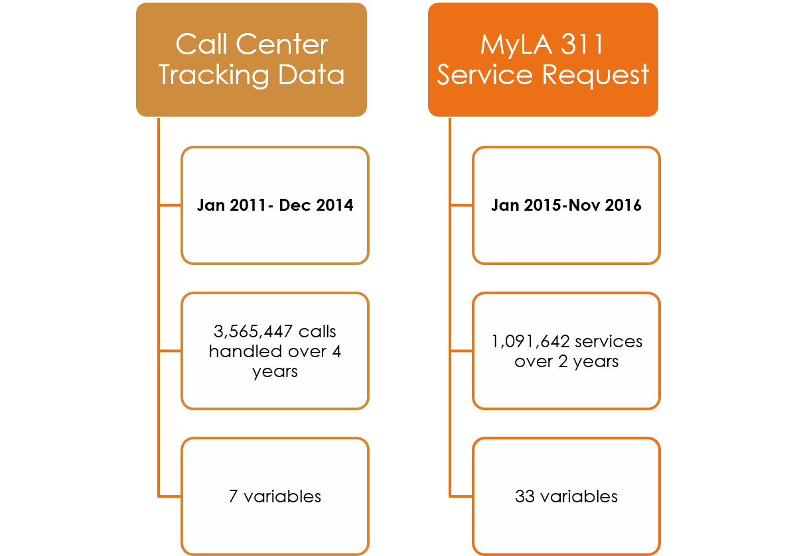
Introduction
Datasets Summary
Project Goal
Provide meaningful suggestions to the City of Los Angeles to better allocate resources to serve residents
Optimize personnel assignment across workdays and months, so as to improve the working efficiency of 311 call center
Notes:
Launched in December 1, 2007, 311 Call Center is a “one call to city hall” program for non-emergency city services. By analyzing numerous service request and call center datasets, our aim is to
provide meaningful suggestions to the government of Los Angeles to better allocate resources to serve tenants.
Optimize personnel assignment across workdays and months, so as to improve the working efficiency of 311 call center.
MyLA311
https://myla311.lacity.org
https://www.lacity.org/311-services
Call center:
https://www.ladbs.org/our-organization/customer-services/contact-us/customer-call-center
(2) censusreporter.org
The censusreporter.org provides demographical information for each regions, such as income level, education level, which will help us to compare the relationship between requests and different region.

Slide 3
Executive Summary
Findings
Seasonality is related to the volume of requests.
Requests for Bulky items and Graffiti Removal are the highest in the departments BOS and OCB.
Requests are high on weekdays through phone calls.
High income and education areas are negatively correlated to requests such as Graffiti Removal.
Recommendations
Allocate resources based on popular requests in different areas.
Implement IVR or automated answering service for popular requests and departments.
Promote other request channels such as apps and websites.
Implement targeted awareness campaigns to specific segmentations of residents.

Slide 4

MyLA311 Service Request
Seasonality
Geographical
Service Efficiency
Request Channels

Slide 5
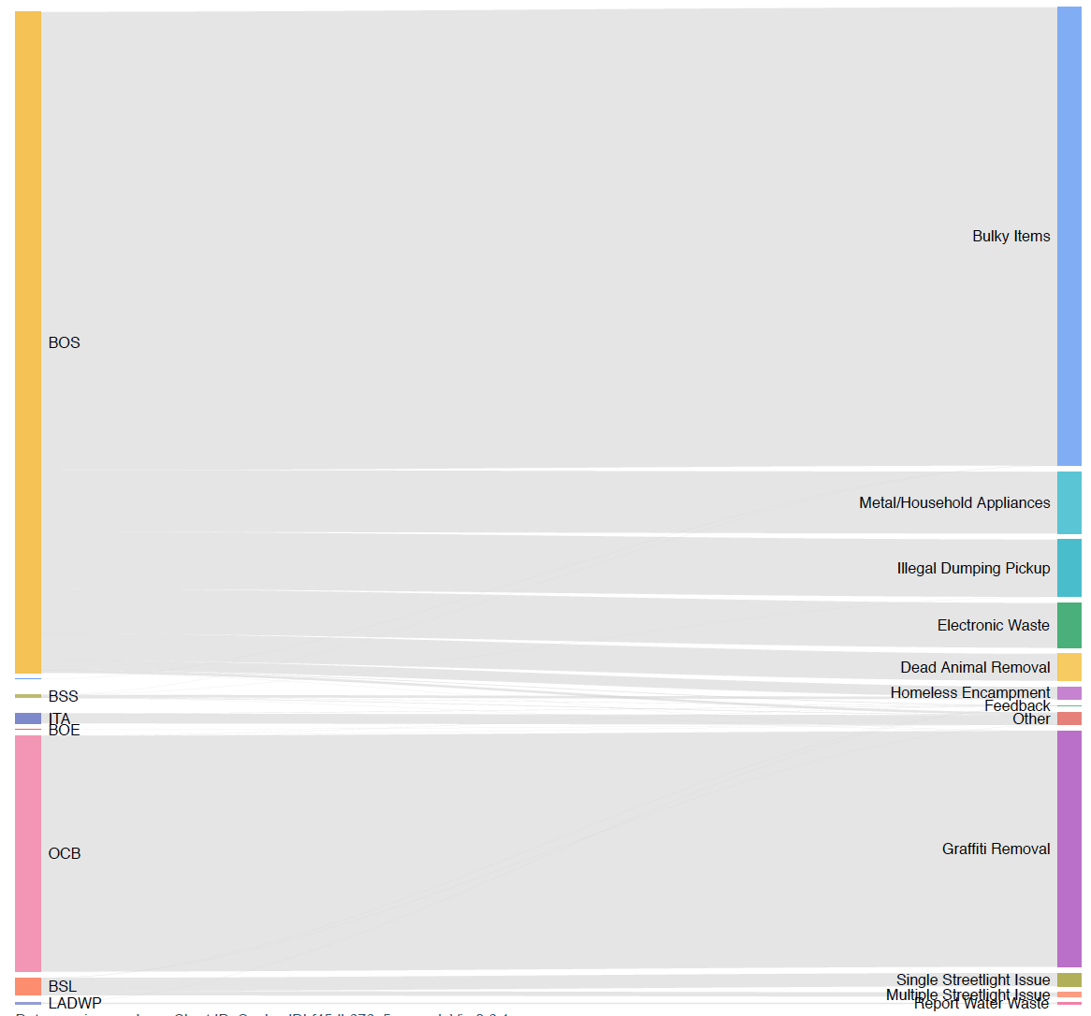
Service Request Overview Request Types and Departments
7 departments
BOS (71%)
OCB (25%)
12 Service Types
Bulky Items (49%)
Graffiti Removal(25%)
Train staff in corresponding departments to quickly process these items
Notes:
Bulky Items and Graffiti Removal are the most popular requests

Slide 6
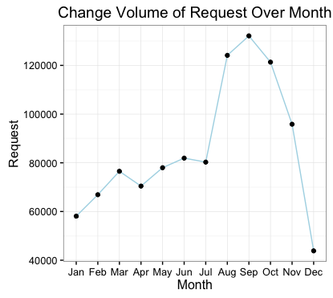
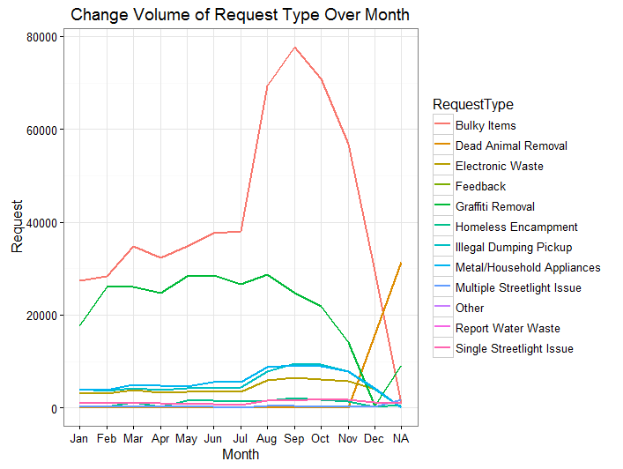
Seasonality Analysis by month
August through October are the busiest
Increase seasonal hires to meet the demand in service volume

Slide 7
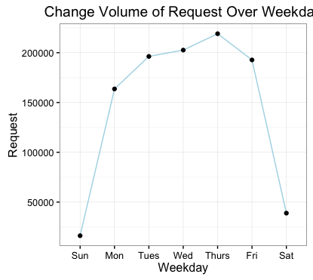
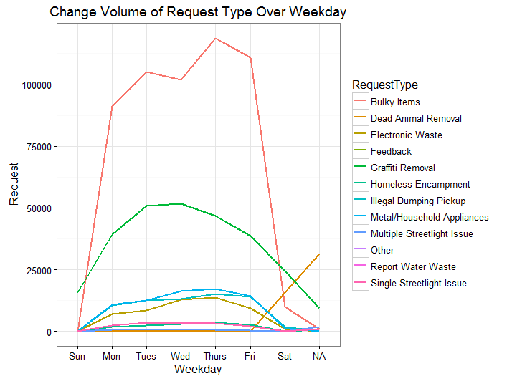
Seasonality Analysis by weekday
Weekdays, especially Wednesday to Friday, are the busiest
Anticipate high volume of requests and schedule staff accordingly

Slide 8
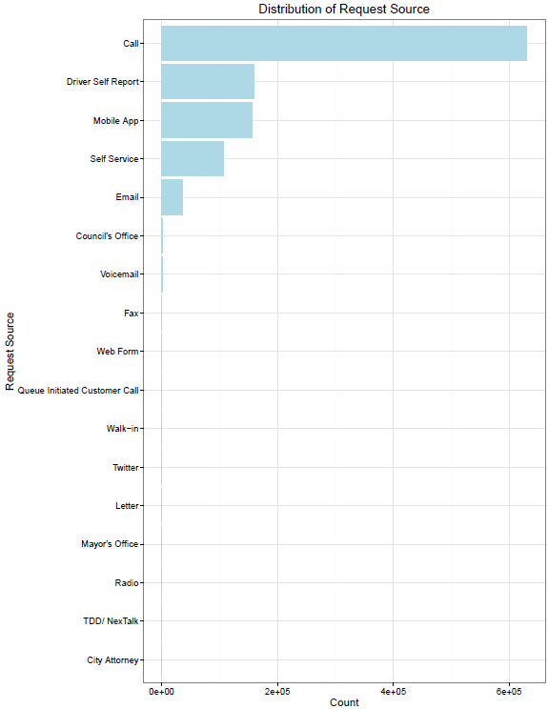
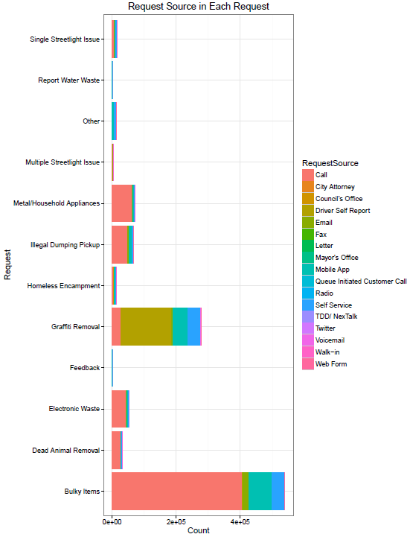
Request Channels
Phone is the most popular channel of placing service request(58%), followed by Self Driver Report(15%), Mobile App(14%), Self Service(10%) and Email (3%)
Call center: Implement automated answering services
Mobile App: only 14% of total volume. To increase, could 1) Create public campaigns to encourage the use of this channel; 2) Promote the App through call center messaging
Notes:
No NA’s
Take a deeper dive into Request Source by different service request types, we can see that about half of the all services processed are through phone calls for bulky item removal. There is also a significant amount of volume for graffiti removal requests generated from Driver Self Report. For high volume request types such as Bulky Items, Grafitti Removal, Metal/Household Appliances, how to entice users to switch from phone to web form or app to place service requests would be an area that the City should aim to tackle.

Slide 9
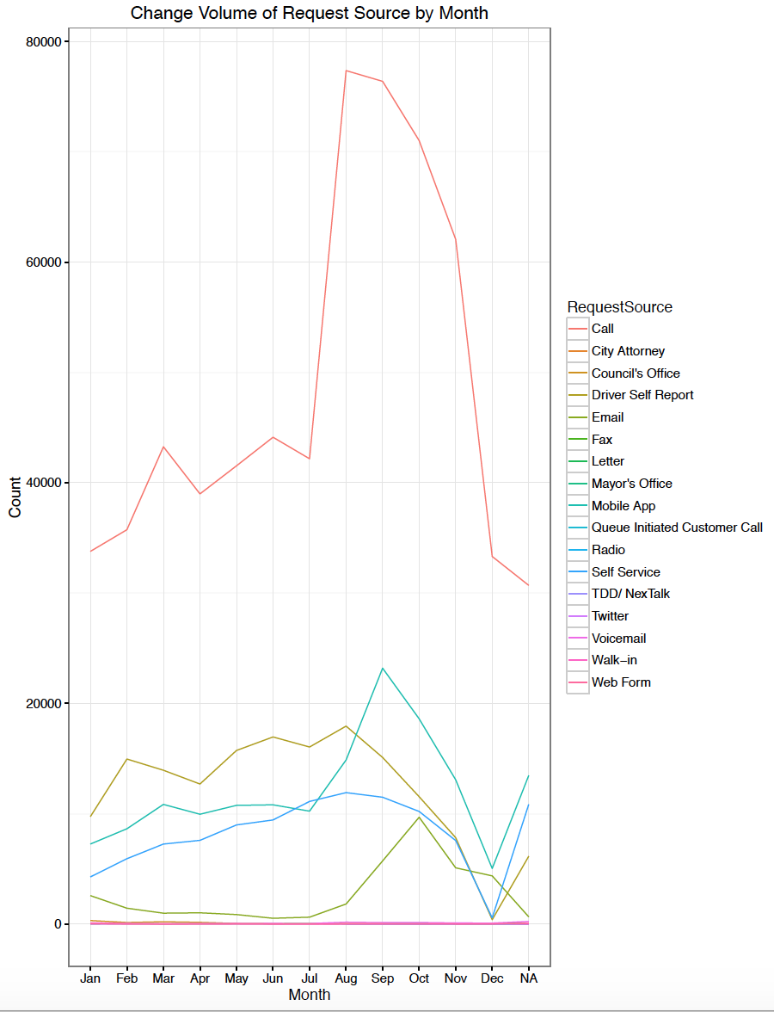
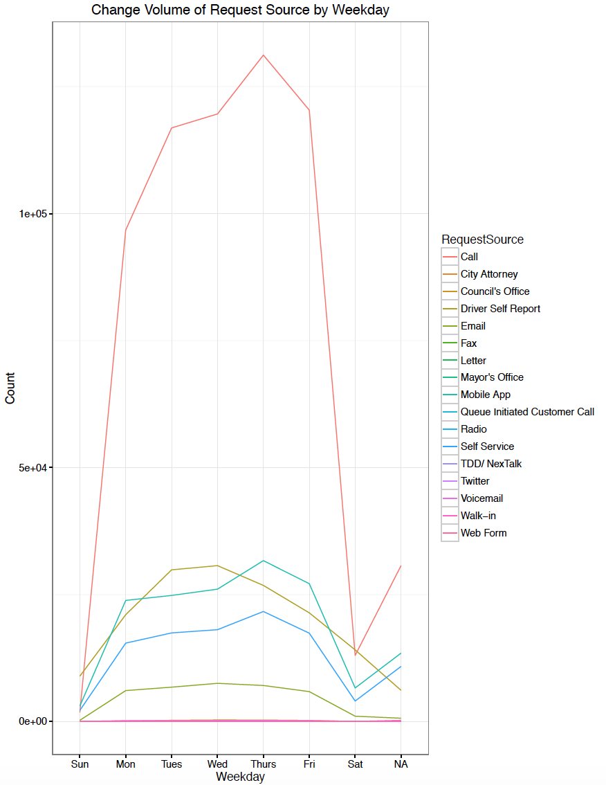
Request Channels by month/weekday
Similar patterns of volume through various request sources, in line with the overall trendline
Notes:
Dip in December because missing one month’s data

Slide 10
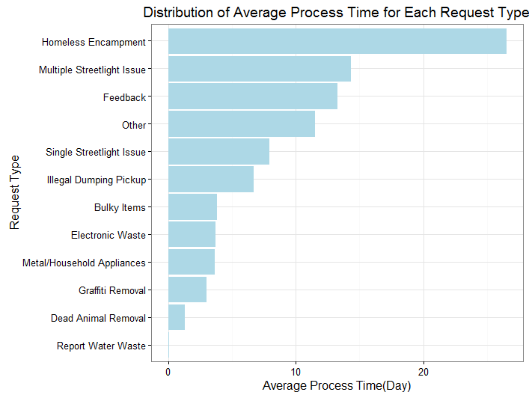
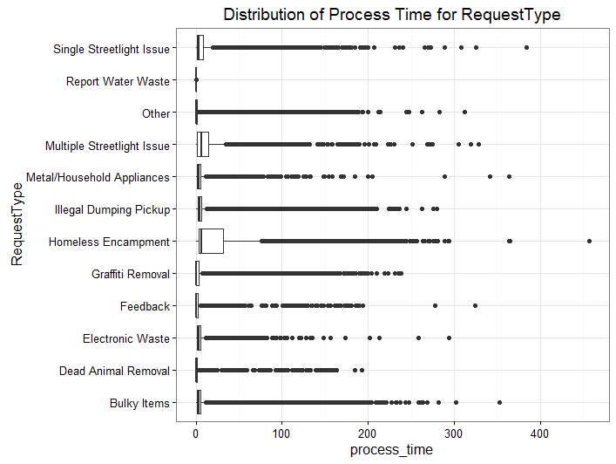
Service Efficiency Analysis
Average Process Time for Homeless Encampment is the longest (~28 days), and Dead Animal Removal and Report Water Waste the shortest（0-2 days)
Many significant outliers for Process Time to be addressed
Limitation of analysis: reporting error & method of measurement
Notes:
Method: Time Processed=Updated-created (might not be reflective of true value due to reporting error)
Outliers might be due to reporting error
Can be used as a benchmark for department/employee

Slide 11
Geographical Analysis

Slide 12
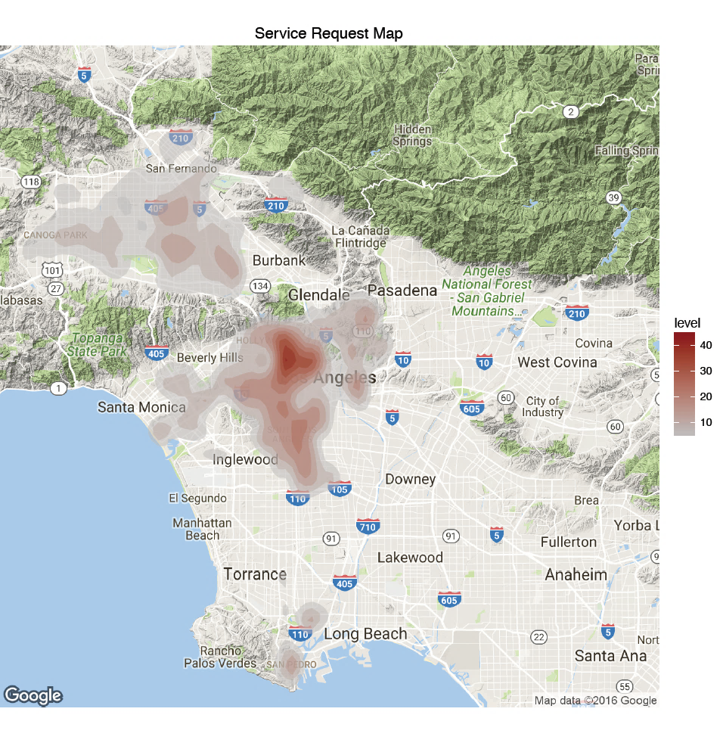
Service Request Map
Concentrated in north-west Los Angeles
We suggest the government to allocate more resources in those area

Slide 13
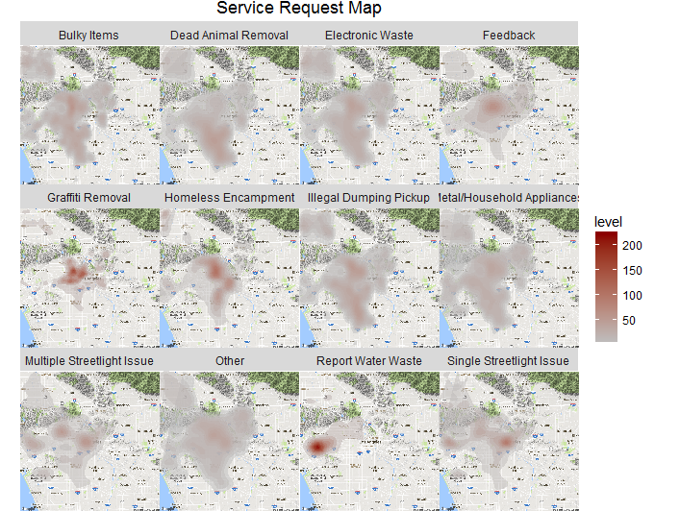
Service Request Map by Type
Graffiti Removal/Illegal house dumping/homeless encampment are concentrated in center LA
Report Water waste has high level in Beverly Hill area

Slide 14
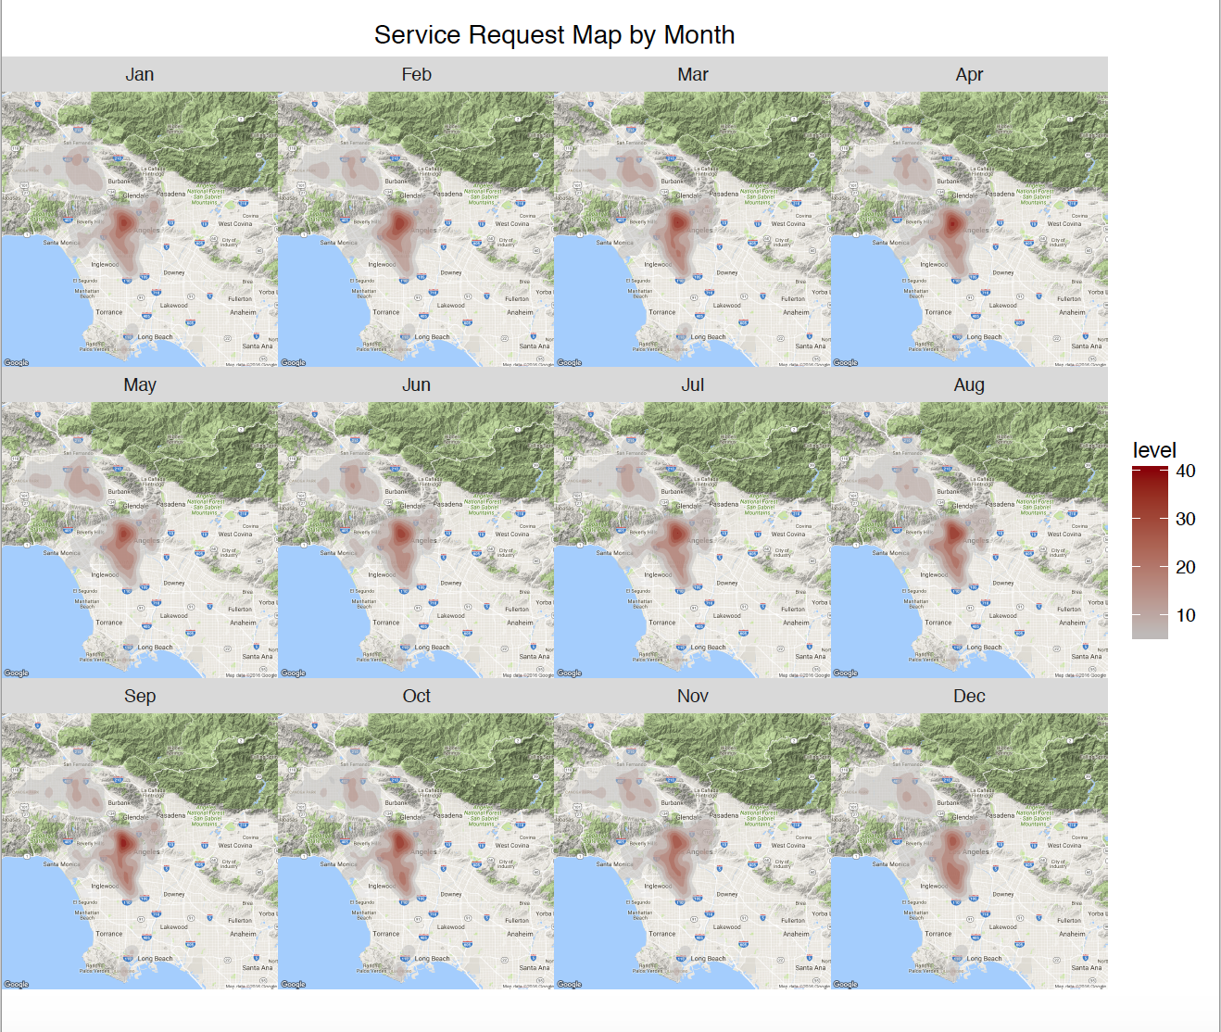
Service Request Map by Month
Summer time (July., Aug. and Sept.) are the most busiest time
Area covered are very similar

Slide 15
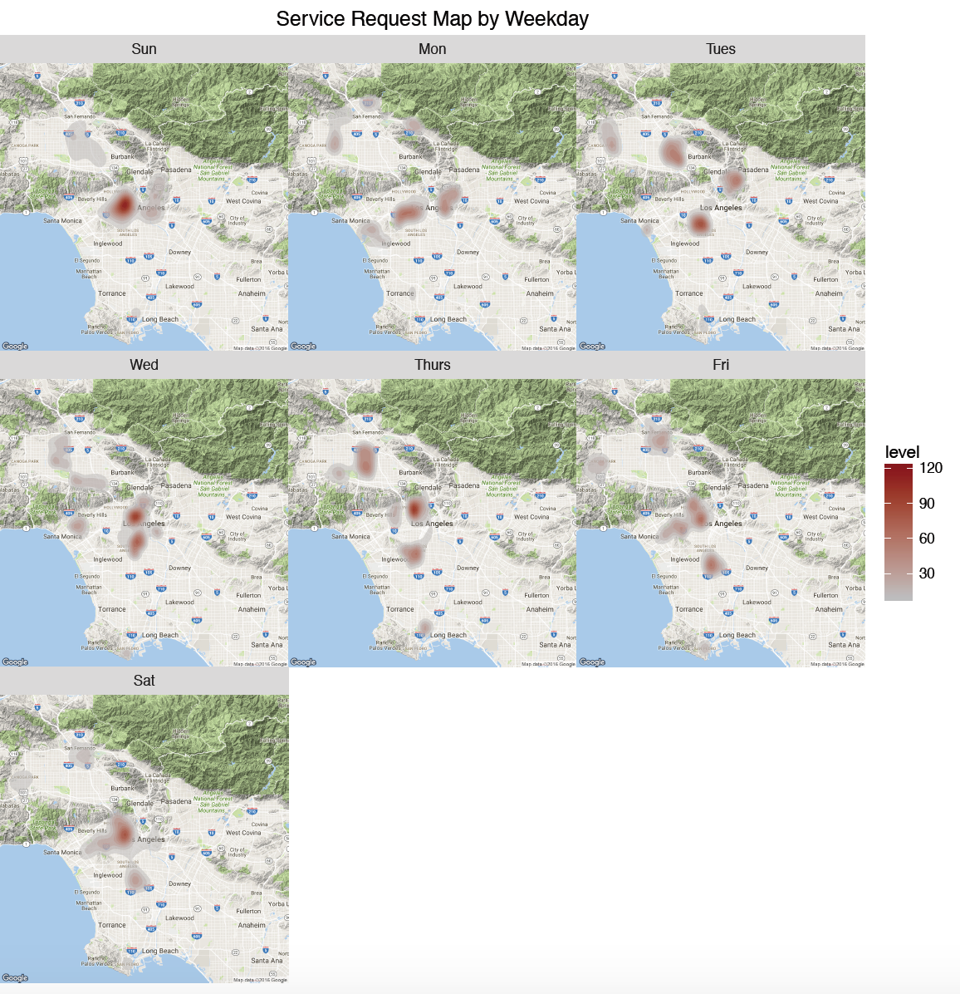
Service Request Map by Weekday
Sundays seem to have the highest requests level followed by Wednesday and Thursday
Center of requests change by weekdays

Slide 16
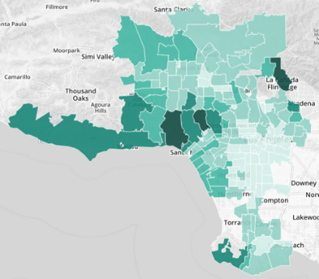
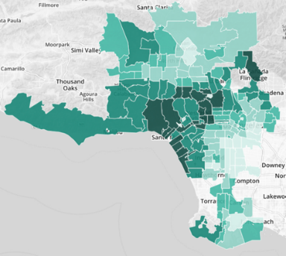
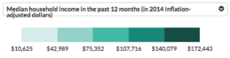
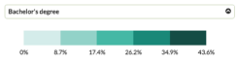
Median household income and bachelor’s degree heatmap map
Source: censusreporter.org

Slide 17
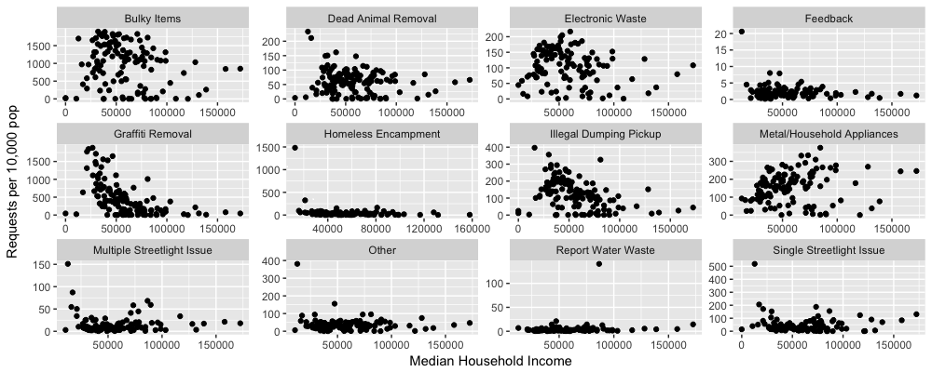
Demographic Analysis Request by Type vs Median Household Income
Graffiti Removal and illegal dumping pickup are clearly negatively correlated with median household income

Slide 18
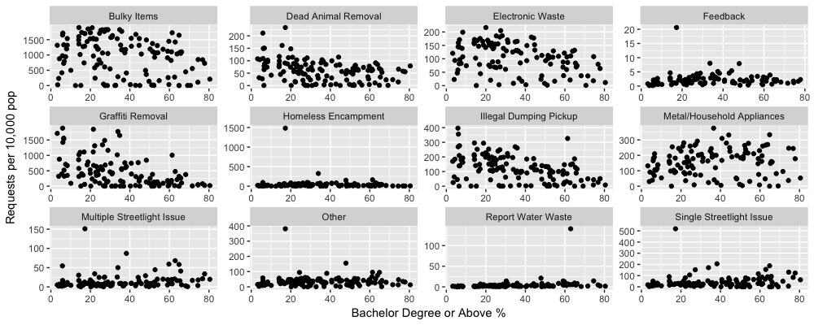
Demographic Analysis Request Type vs Education Level
Graffiti Removal/Illegal dumping pickup are also negatively related to education level
Bulky items/electronic waste/dead animal removal have weak negative correlation with education level

Slide 19
Call Center

Slide 20
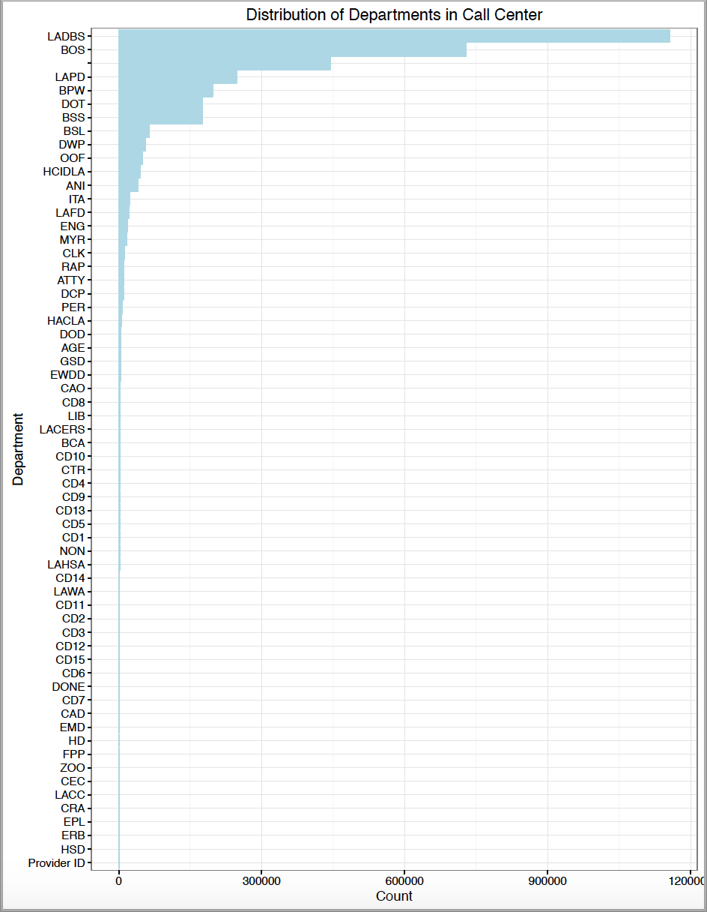
Department Distribution
LADBS and BOS have the most number of requests
Calls to LADBS are mostly permit services such as applications, reviews, and requests
Increase awareness for residents to use LADBS to process requests

Slide 21
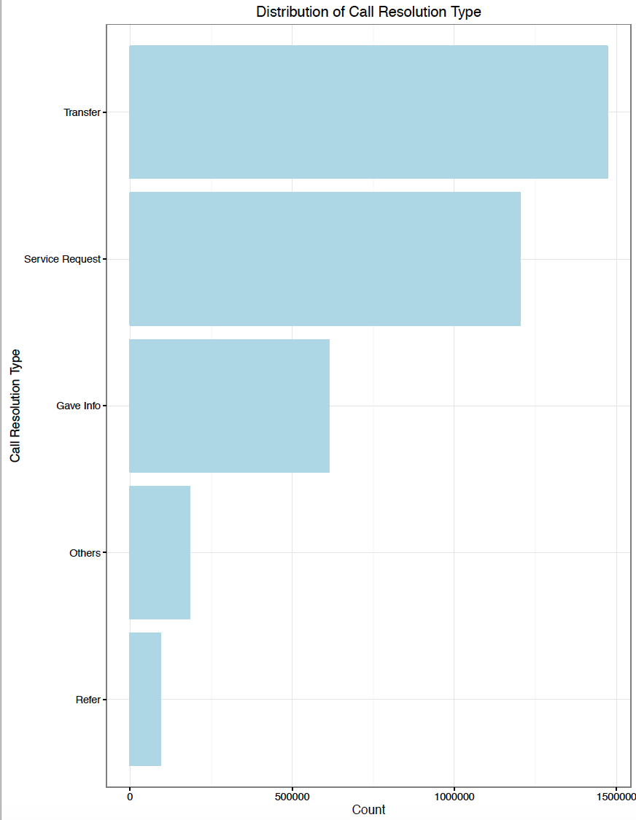
Call Resolution Distribution
Transfer of call is the most frequent resolution
Implement automated answering service with service and department options for users to pick from

Slide 22
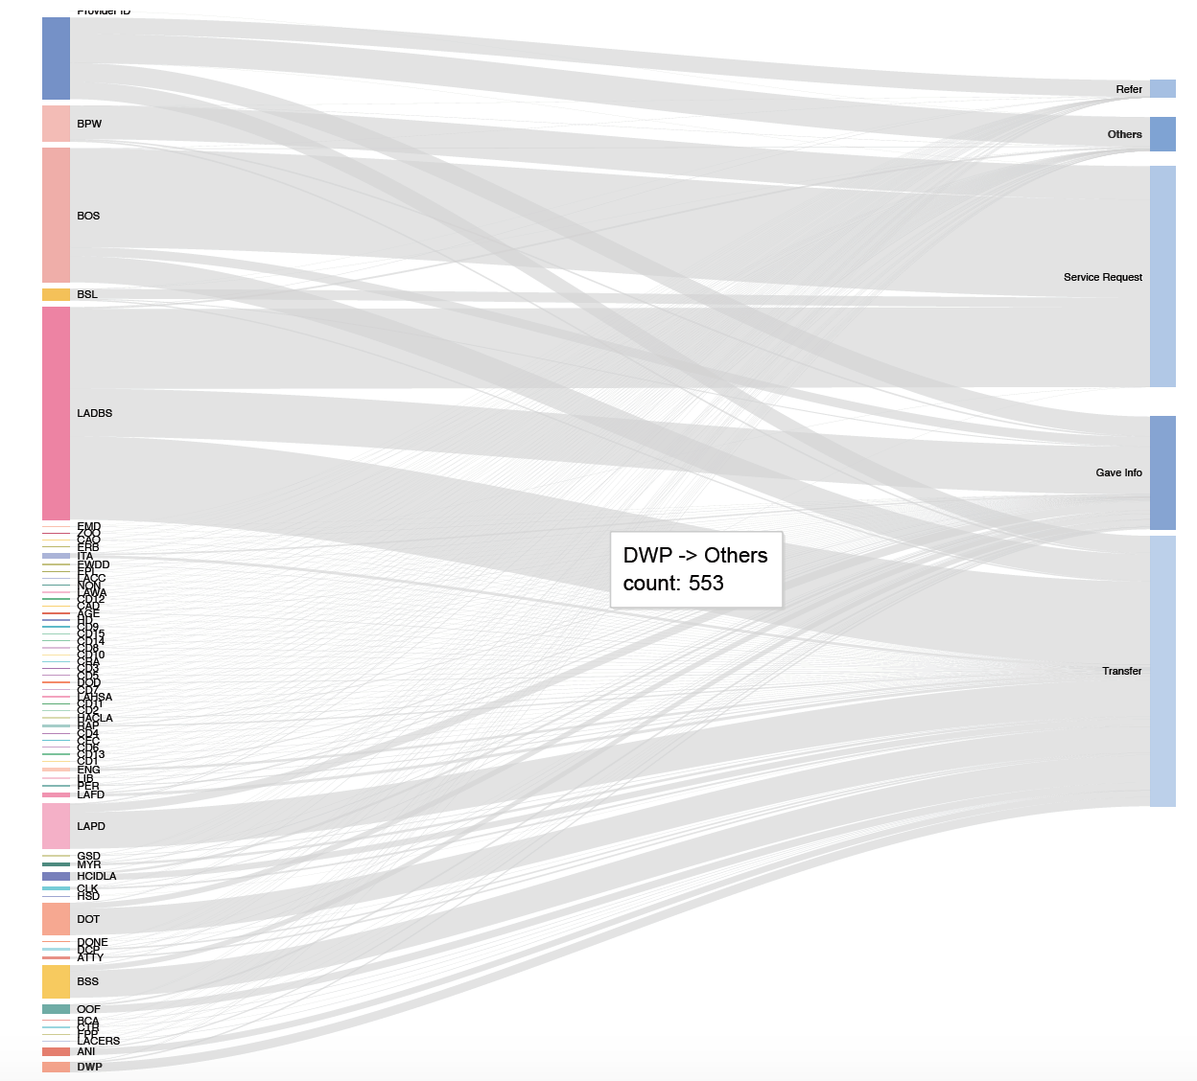

Slide 23
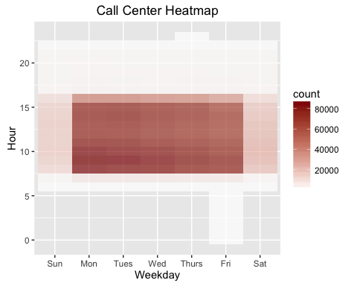
Time and Day Heatmap
Busiest during weekdays between 7:00AM-4:00PM
Allocate more staffs during mornings and mondays and tuesdays.
Notes:
Call center hours: 8:00 am-4:45 pm daily, including weekends and all holidays except Thanksgiving and Christmas.

Slide 24
Summary: Key Takeaways
Seasonality to the calls and the requests
Automated answering service with options for the most popular service requests and departments
Short promotional message for other request channels in the beginning of the call
Better resource allocation to specific geographical locations with high demand of a certain request type
Awareness campaign targeting certain segmentations of residents to reduce requests
Notes:
Call center training and user manual/directory

Slide 25
Thank you!

Slide 26
Appendix

Slide 27
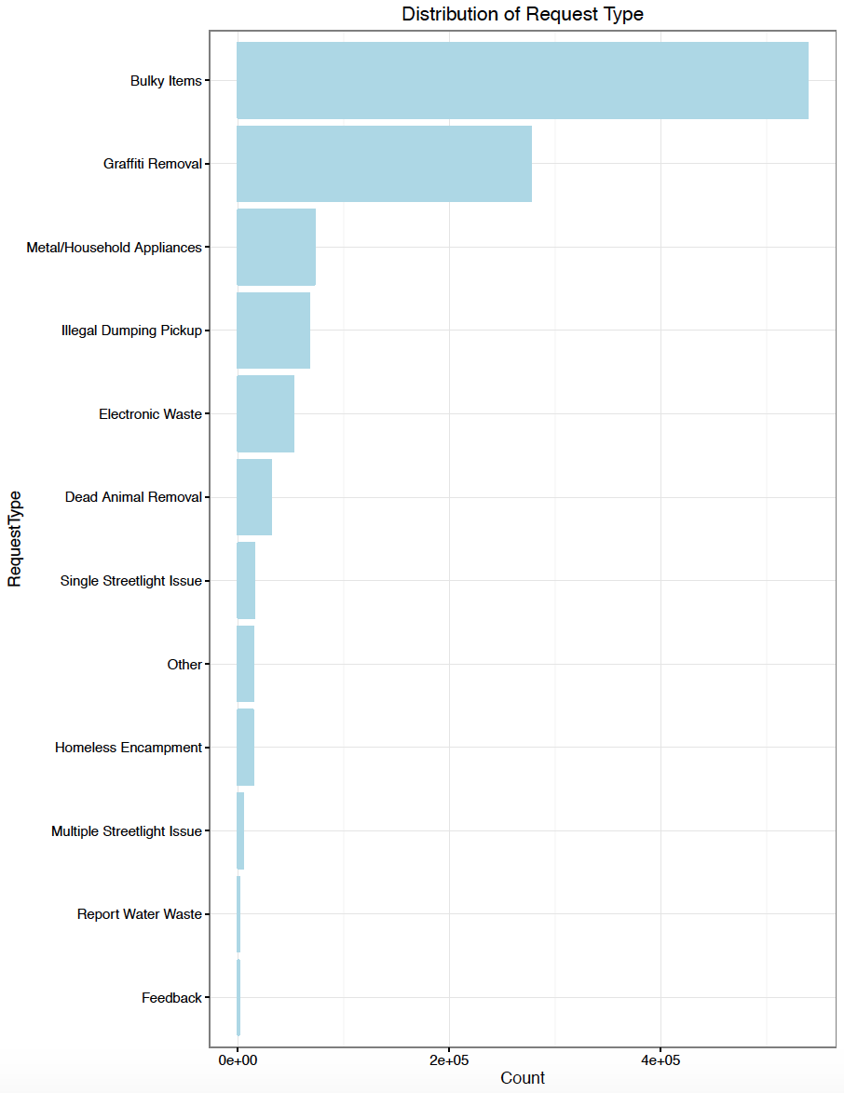
Distribution of Request Type

Slide 28
Other Analyses
APC
Council District
Anonymous or Not
AssignTo

Slide 29
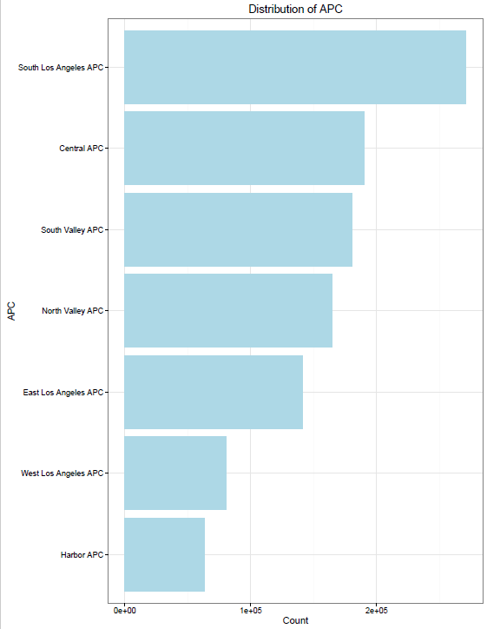
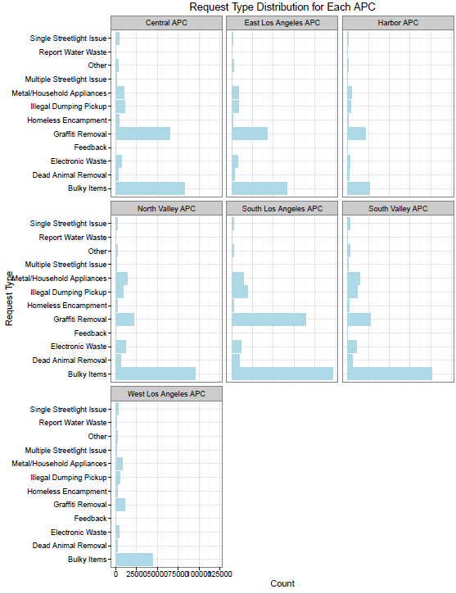
SR Type Analysis by APC
Notes:
-To add: Request type x APC x Day of week?

Slide 30
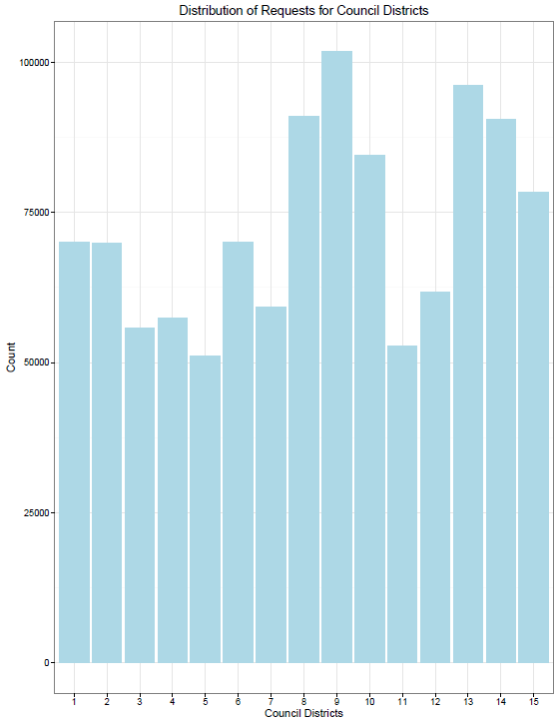
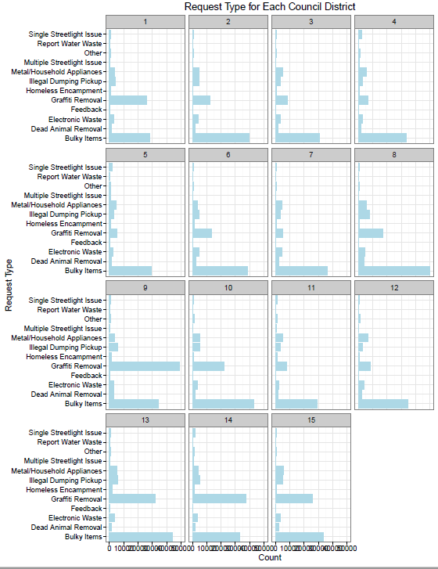
SR Type Analysis by Council District

Slide 31
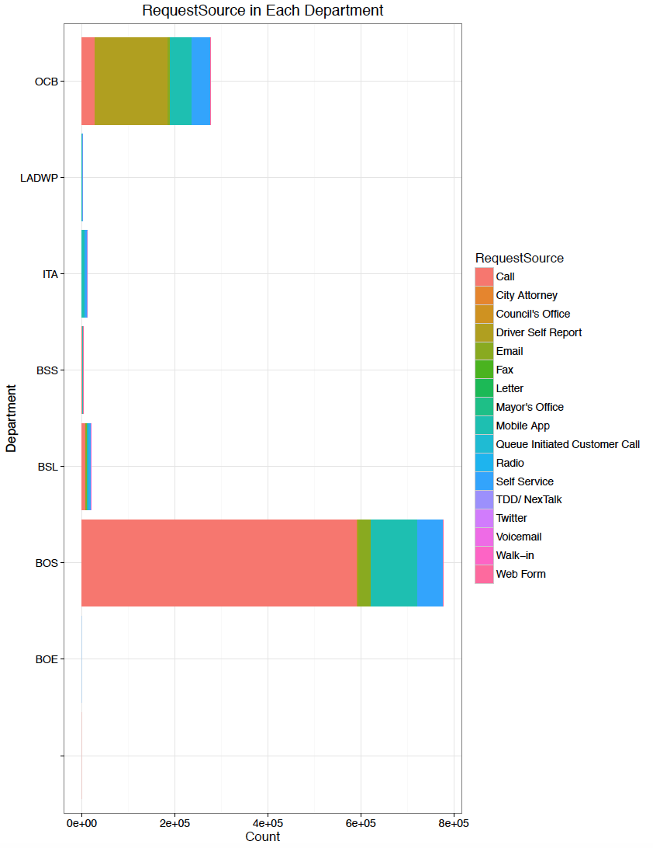
SR Type Analysis by Department

Slide 32
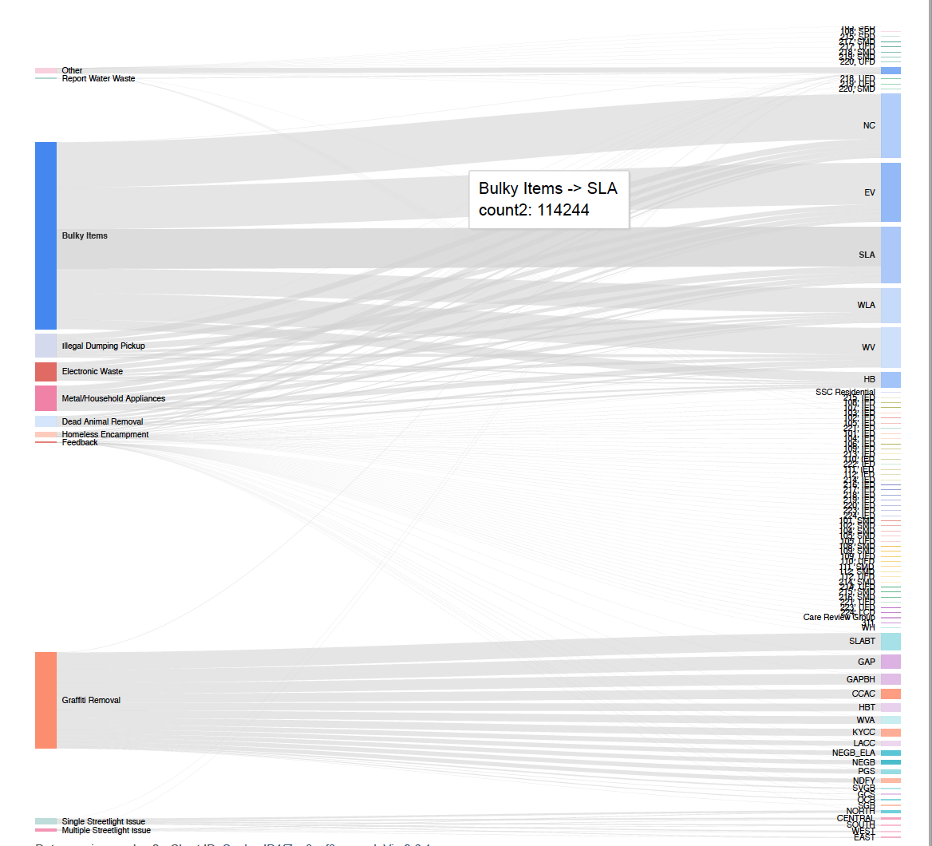
Request Type by Owner

Slide 33
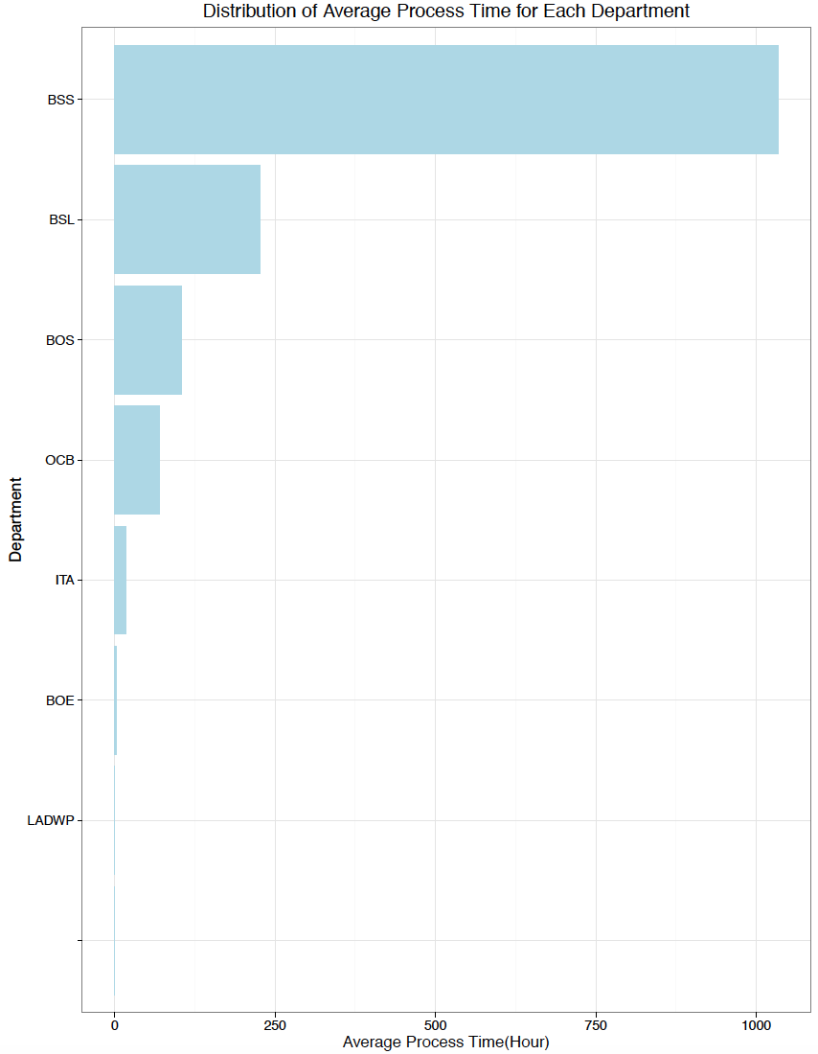
Service Efficiency by Department

Slide 34

Anonymous or Not

